Slide 1
Bot!Battle!:
Game Display Team
Josiah Hertzler
Taha Siddique
Jack McFann
Tom Hoffman
Sawyer Brown

Slide 2
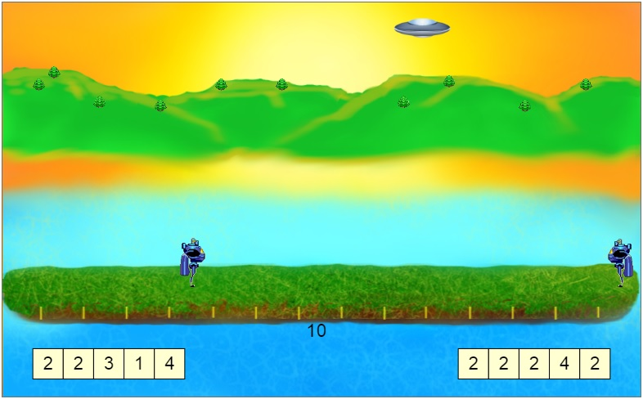
The Big Picture

Slide 3
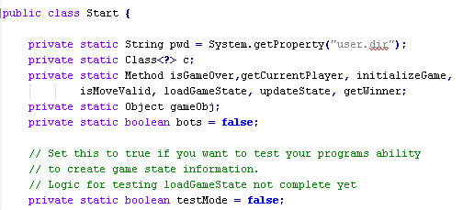
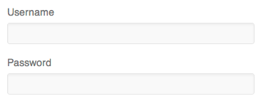
Three Main Tasks
Game Evaluation
Game Display
Web Service

Slide 4
Our Job
Flexible animation commands
Intuitive replay screen
Server code to find completed games
A space for users to test code
Multiple ways to upload
Can edit uploaded code
Creation of a Game Challenge

Slide 5
Design Phase

Slide 6
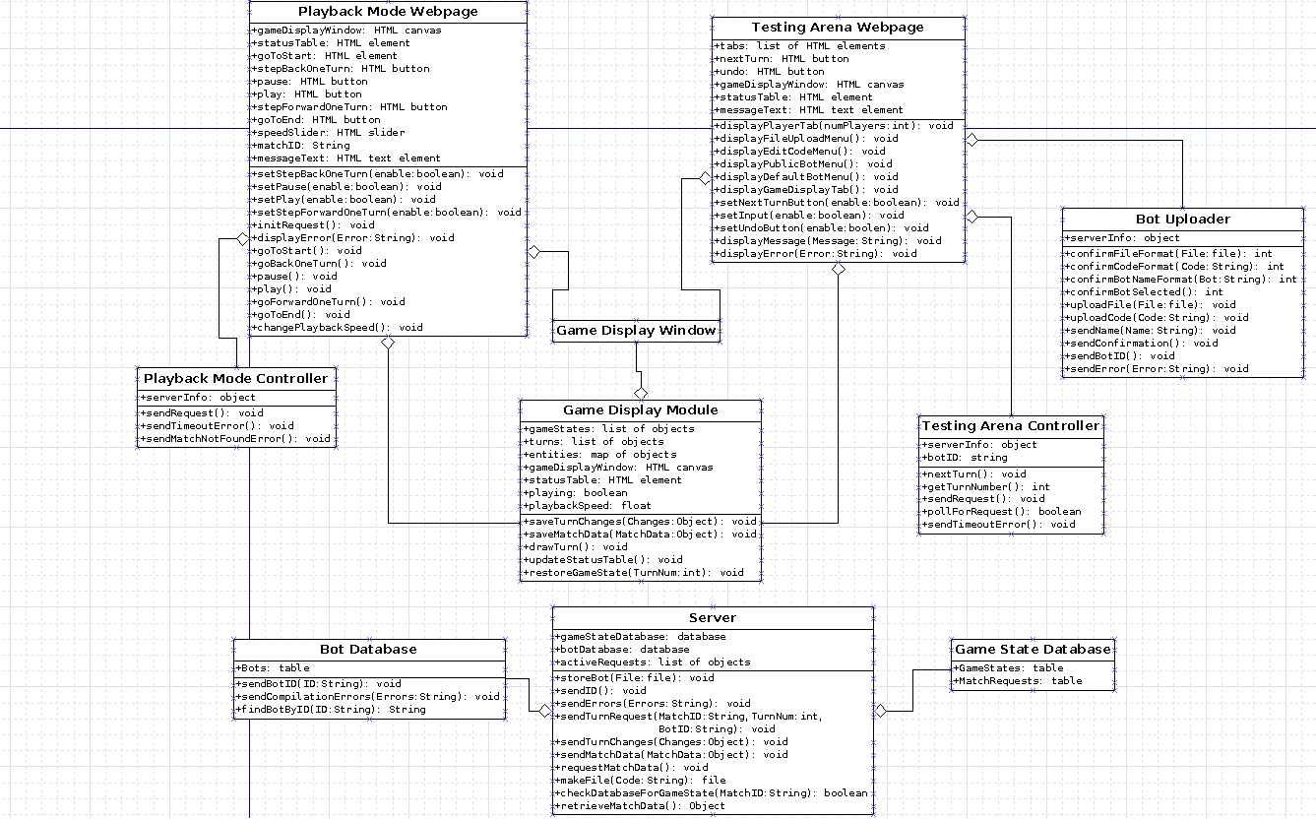
Testing Arena
Playback Mode

Slide 7
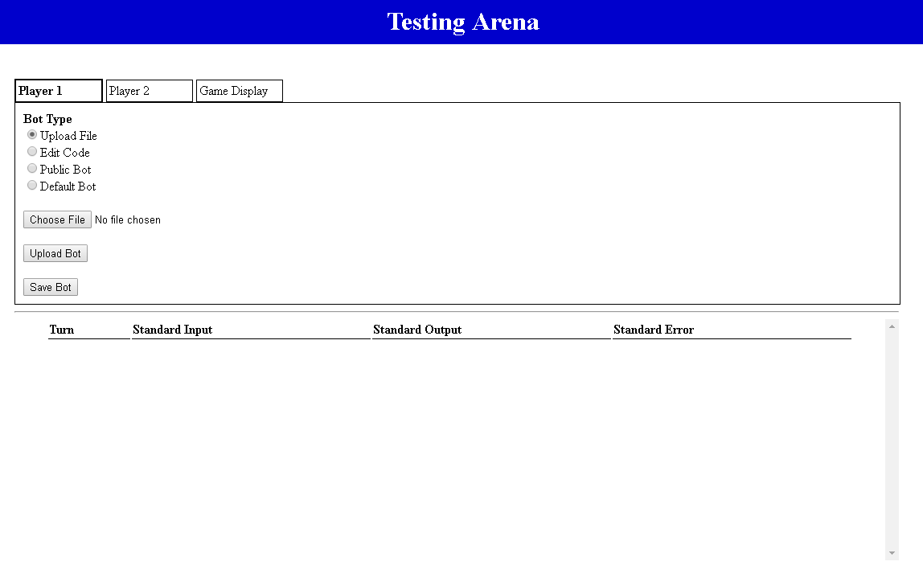
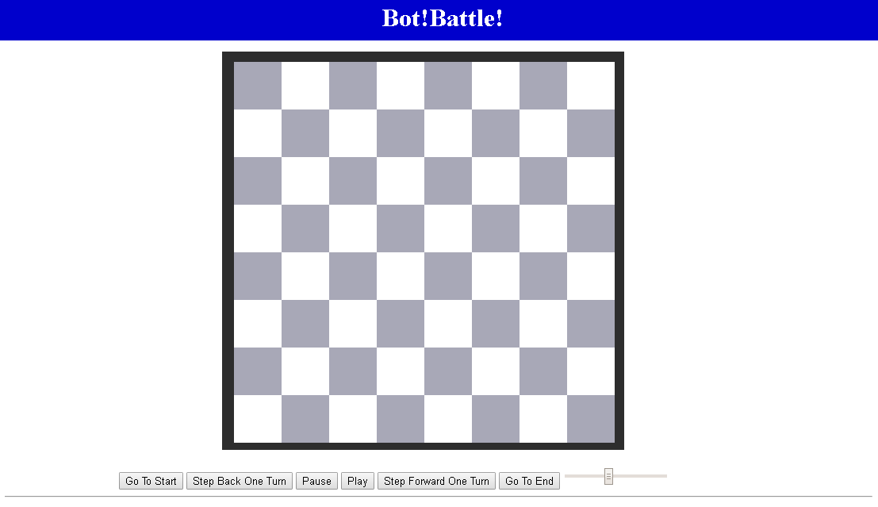
Displaying A Game
Testing Arena
Playback Mode

Slide 8
Playback Mode
View completed matches
Speed Slider
Turn by turn
Easy to use

Slide 9



Slide 14


Slide 15



Slide 16
Testing Arena
Debugging Mode
Update bot each turn
Upload File
Edit Code
Test against other bots
Public Bot
Default Bot

Slide 18
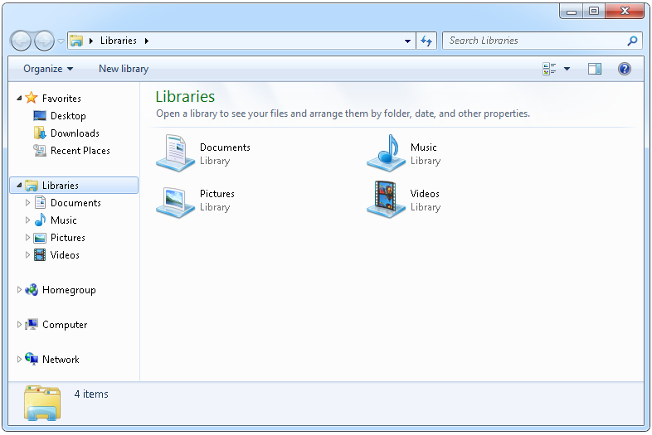

Slide 19
//Template Code for bot
public static void main(String args) {
System.out.print(“Hello!”);
}

Slide 22
Capture The Flag
Math Based Game Challenge
Balance Attack and Defense
Many layers of strategy
Aggressive vs Conservative
Attack Focus vs Defense

Slide 23


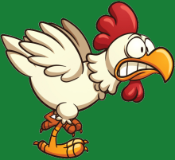


Flags Captured: 0
Flags Captured: 0

Slide 24
Questions?

